Slide 1
Design and Analysis of Algorithms (UE20CS251)
Unit IV - Space and Time Tradeoffs
Mr. Channa Bankapur
channabankapur@pes.edu

Slide 2
Space and Time Tradeoffs
Input Enhancement
preprocess the problem’s input, in whole or in part, and store the additional information obtained to accelerate solving the problem afterward.
Eg: Counting methods of sorting, Horspool’s algorithm, Boyer-Moore’s algorithm.
Pre-structuring
use of extra space to facilitate faster and/or more flexible access to the data.
Eg: Hashing, B-Trees
Dynamic Programming

Slide 3
Sorting by Counting
Comparison Counting Sorting
For each element of the list, count the total number of elements smaller than this element.
These numbers will indicate the positions of the elements in the sorted list.
Distribution Counting Sorting
Suppose the elements of the list to be sorted belong to a finite set (aka domain).
Count the frequency of each element of the set in the list to be sorted.
Scan the set in order of sorting and print each element of the set according to its frequency, which will be the required sorted list.

Slide 4
Input Enhancement
→ Sorting by Counting
→→ Comparison Counting Sorting
For each element of the list, count the total number of elements smaller than the element.
These numbers indicates the positions (0-based) of the elements in the sorted list.
Eg: 62 31 84 96 19 47
# lesser elements: 3 1 4 5 0 2
19 31 47 62 84 96
0 1 2 3 4 5

Slide 5
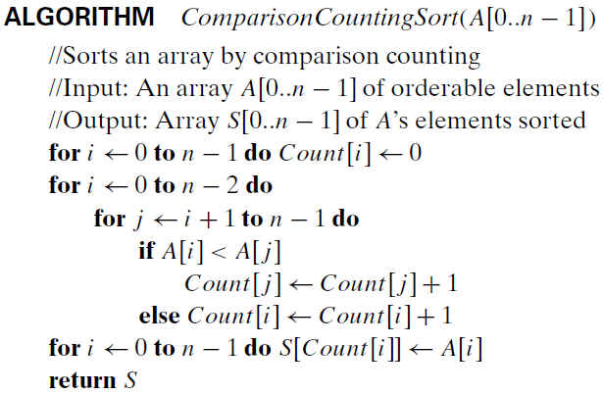

Slide 6
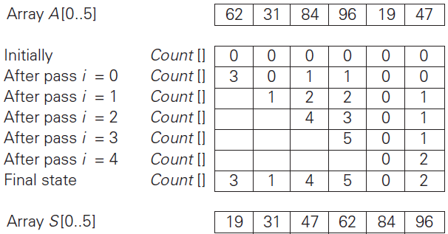

Slide 7


Optimal number of key moves.
Does it sort when there are duplicate elements?
If so, is the sort stable?
What happens if the condition A[i] < A[j] is replaced with A[i] <= A[j] ?
Stable, but not in-place. Takes O(n) space.

Slide 8
Q: Write an efficient algorithm to sort a list of n 0s and 1s.
Can it be done faster than O(n log n)?

Slide 9
Q: Write an efficient algorithm to sort a list of n 0s and 1s.
Can it be done faster than O(n log n)?
Q: Write an efficient algorithm to sort a list of n 0s, 1s and 2s.
Can it be done faster than O(n log n)?

Slide 10
Q: Write an efficient algorithm to sort a list of n 0s and 1s.
Can it be done faster than O(n log n)?
Q: Write an efficient algorithm to sort a list of n 0s, 1s and 2s.
Can it be done faster than O(n log n)?
Q: Write an efficient algorithm to sort a list of n elements where the elements belong to set of natural numbers [0..100], and 101 << n. Can it be done faster than O(n log n)?

Slide 11
Q: Write an efficient algorithm to sort a list of n 0s and 1s.
Can it be done faster than O(n log n)?
Q: Write an efficient algorithm to sort a list of n 0s, 1s and 2s.
Can it be done faster than O(n log n)?
Q: Write an efficient algorithm to sort a list of n elements where the elements belong to set of natural numbers [0..100], and 101 << n. Can it be done faster than O(n log n)?
Q: Write an efficient algorithm to sort a list of n elements where the elements belong to set of m elements, and m << n. Can it be done faster than O(n log n)?

Slide 12
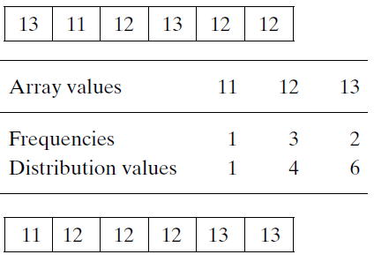
Input Enhancement
→ Sorting by Counting
→→ Distribution Counting Sorting

Slide 13
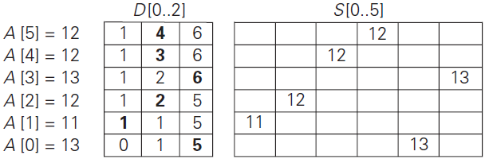

Slide 14
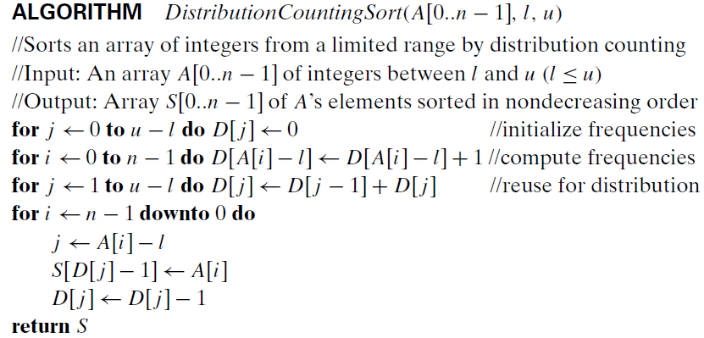
Input Enhancement
→ Sorting by Counting
→→ Distribution Counting Sorting

Slide 15
Trace the algorithm for sorting 5-star ratings of 7 people.
(A, 3), (B, 5), (C, 2), (D, 3), (E, 3), (F, 5), (G, 3).
Alphabet: {1, 2, 3, 4, 5} OR {2, 3, 4, 5} with l=2, u=5.
Frequencies: 1, 4, 0, 2. ⇒ Distributions: 1, 5, 5, 7.
Sorted list: (A, 3), (B, 5), (C, 2), (D, 3), (E, 3), (F, 5), (G, 3).

Slide 16
Space complexity: O(u-l) distributions and O(n) for final sorting.
Time complexity: O(n + (u-l)).
It is O(n) when u-l ∈ O(n).

Slide 17

Input Enhancement in String Matching:
Input Enhancement to improve the average-case/amortized efficiency.
Horspool’s algorithm
Boyer-Moore algorithm
Robin-Karp algorithm
Finite State Automaton
Knuth-Morris-Pratt algorithm

Slide 18
Consider the problem of searching for genes in DNA sequences.
A DNA sequence is represented by a text of the alphabet {A, C, G, T} and the gene segment is the pattern.
Eg: Text with n = 18 and pattern with m = 5.
DNA Sequence: A C G T T A G C A G C G C A G C G C
Gene segment: A G C G C

Slide 19
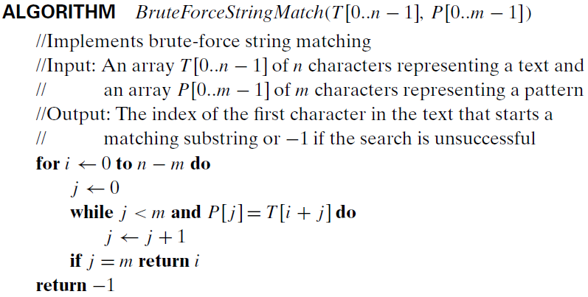

Slide 20
NaiveStringMatch(T[0..n-1], P[0..m-1])
for i ← 0 to n-m
j ← 0
while (j < m and T[i+j] = P[j])
j ← j + 1
if(j = m) return i
return -1
---------------------------------------
NaiveStringMatch2(T[0..n-1], P[0..m-1])
for i ← m-1 to n-1
j ← 0
while (j < m and T[i-j] = P[m-1-j])
j ← j + 1
if(j = m) return i-(m-1)
return -1

Slide 21
NaiveStringMatch2(T[0..n-1], P[0..m-1])
for i ← m-1 to n-1
j ← 0
while (j < m and T[i-j] = P[m-1-j])
j ← j + 1
if(j = m) return i-(m-1)
return -1
---------------------------------------
NaiveStringMatch3(T[0..n-1], P[0..m-1])
i ← m-1
while (i < n)
j ← 0
while (j < m and T[i-j] = P[m-1-j])
j ← j + 1
if(j = m) return i-(m-1)
i ← i+1
return -1

Slide 22


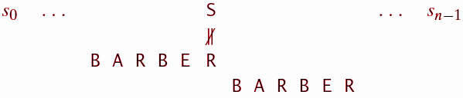
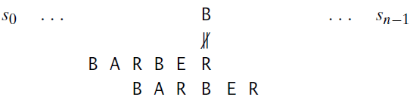

Slide 23
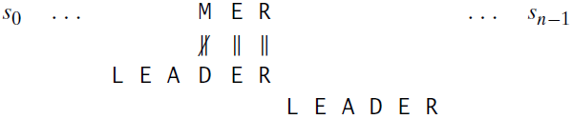
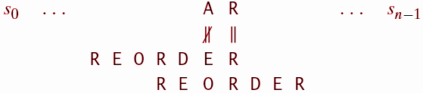

Slide 24
Eg: Pattern AGCGC
Shift table: A C G T
4 2 1 5
Eg: Gene segment in DNA Sequence using Horspool’s algo.
0 1 2 3 4 5 6 7 8 9 0 1 2 3 4 5 6 7 8 9
A C G T T A G C A G C G C A G C G C
A G C G C
A G C G C
A G C G C
A G C G C
Tbl[ T ] = 5
Tbl[ G ] = 1
Tbl[ C ] = 2

Slide 25
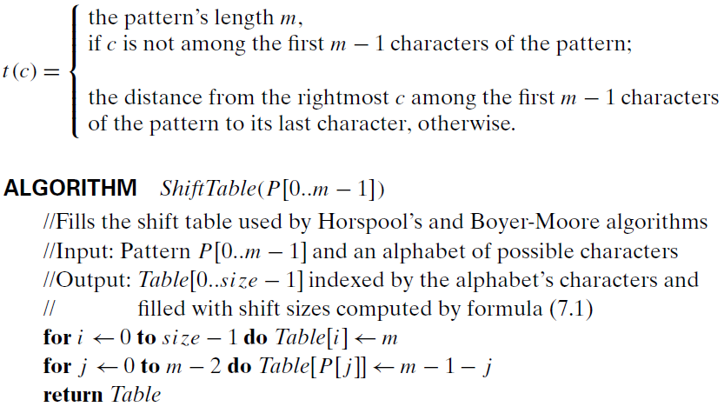

Slide 26
NaiveStringMatch3(T[0..n-1], P[0..m-1])
i ← m-1
while (i < n)
j ← 0
while (j < m and T[i-j] = P[m-1-j])
j ← j + 1
if(j = m) return i-(m-1)
i ← i+1
return -1
---------------------------------------
HorspoolMatching(T[0..n-1], P[0..m-1])
STbl[alphabet size] ← ShiftTbl(P[0..m-1])
i ← m-1
while (i < n)
j ← 0
while (j < m and T[i-j] = P[m-1-j])
j ← j + 1
if(j = m) return i-(m-1)
i ← i + STbl[ T[i] ]
return -1

Slide 27
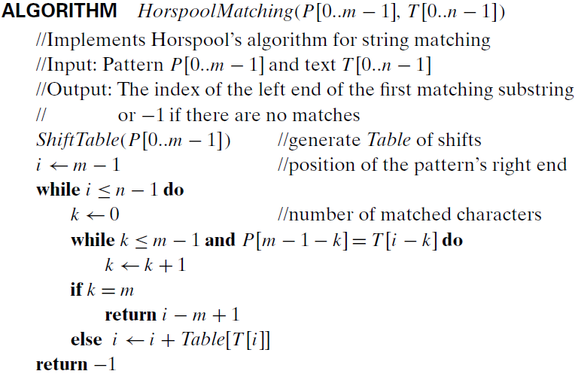

Slide 28

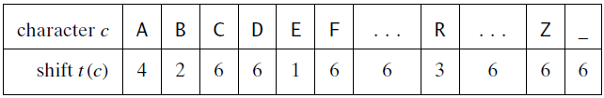
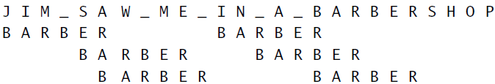

Slide 29
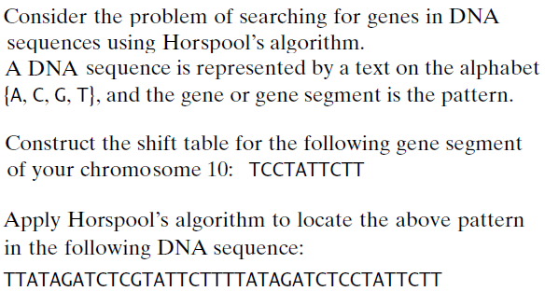

Slide 30
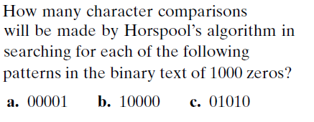

Slide 31

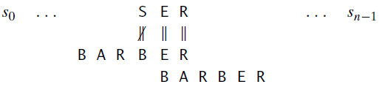
Boyer-Moore Algorithm:
Bad-symbol shift

Slide 32
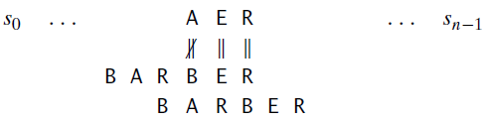


Slide 33
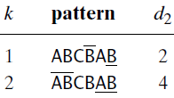
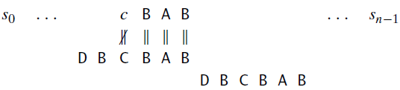
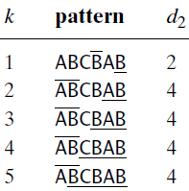
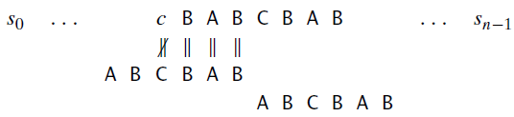
Boyer-Moore Algorithm:
Good-suffix shift

Slide 34
Boyer-Moore Algorithm:
Step 1: For a given pattern and the alphabet used in both the pattern and the text, construct the bad-symbol shift table as described earlier.
Step 2: Using the pattern, construct the good-suffix shift table as described earlier.
Step 3: Align the pattern against the beginning of the text.
Step 4: Repeat the following step until either a matching substring is found or the pattern reaches beyond the last character of the text.
…

Slide 35


Boyer-Moore Algorithm:
Step 4: Repeat the following step until either a matching substring is found or the pattern reaches beyond the last character of the text. Starting with the last character in the pattern, compare the corresponding characters in the pattern and the text until either all m character pairs are matched (then stop) or a mismatching pair is encountered after k ≥ 0 character pairs are matched successfully. In the latter case, retrieve the entry t1(c) from the c’s column of the bad-symbol table where c is the text’s mismatched character. If k > 0, also retrieve the corresponding d₂ entry from the good-suffix table. Shift the pattern to the right by the number of positions computed by the formula

Slide 36
BoyerMooreMatching(T[0..n-1], P[0..m-1])
STbl[alphabet size] ← ShiftTbl(P[0..m-1])
GTbl[1..m-1] ← GoodSuffixTbl(P[0..m-1])
i ← m-1
while (i < n)
j ← 0
while (j < m and T[i-j] = P[m-1-j])
j ← j + 1
if(j = m) return i-(m-1)
d ← max{STbl[T[i-j]] - j, 1}
if(j>0)
d2 ← GTbl[j]
if(d2 > d) d ← d2
i ← i + d
return -1

Slide 37
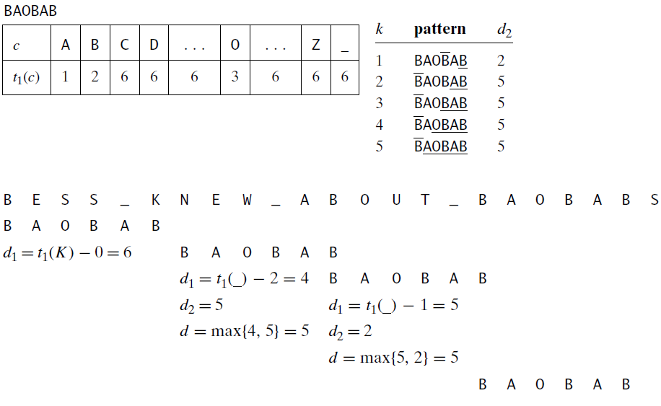

Slide 38
Eg: Pattern AGCGC
Shift table: A C G T
4 2 1 5
Good-suffix table[1..4]: 5, 2, 5, 5
Gene segment in DNA Sequence using Boyer-Moore’s algo.
0 1 2 3 4 5 6 7 8 9 0 1 2 3 4 5 6 7 8 9
A C G T T A G C A G C G C A G C G C
A G C G C
A G C G C
A G C G C
A G C G C
STbl[ T ] = 5
STbl[ G ] = 1
GTbl[2] = 2

Slide 39
Boyer-Moore algorithm:
Create bad-symbol shift table and good-suffix shift table for the pattern: BAOBABAB

Slide 40
Boyer-Moore algorithm:
Create bad-symbol shift table and good-suffix shift table for the pattern: BAOBABAB
A B O Others
1 2 5 8
k: d₂
1: 4
2: 7
3: 2
4: 7
5,6,7: 7

Slide 41
It’s just Space-Time Tradeoffs, not the Space-Time Continuum theory.
</ Space-Time Tradeoffs >

